Slide 1
PREDICTING FUTURE ACTIVITIES OF PERSON AND HUMAN TRAJECTORY USING DEEP NEURAL NETWORK
Submitted by | Guided by
HARSHA PRIYA G | Dr. V MARY ANITA RAJAM
Reg. No. : 2019207029 | Professor
ME-CSE(R) | Anna University - CEG

Slide 2
INTRODUCTION
In today's world we deal with humans and world via live incidents and map in our memory as videos.
Video prediction has broad prospects in real-world scenarios, such as robots planning, autonomous driving, and anomaly detection in surveillance videos.
Learning to predict future frames from a video sequence involves constructing an internal representation that models frame evolutions accurately, including contents and dynamics.

Slide 3
OVERALL OBJECTIVE
To predict human trajectory and future activity using Computer vision techniques and deep learning architectures.
An end-to-end, multi-task learning system utilizing rich visual features about human behavioral information and interaction with their surroundings is to be designed.
To produce meaningful future activity prediction in addition to the path that benefits future path prediction.
To facilitate the training, the network is learned with an auxiliary task of predicting future location in which the activity will happen.

Slide 4
LITERATURE SURVEY
S.No | AUTHOR AND TITLE | METHOD | MERITS | DEMERITS
1 | Jinzhuo Wang et al. “Predicting Diverse Future Frames With Local Transformation Guided Masking.” | A flexible and powerful video prediction system were performed on ROIs and patterns of frame evolutions at the transformation level are learned. | More accurate predictions is made by modeling the visual evolutions. Focused on ROIs to avoid a heavy computational burden. Generated diverse plausible future frames. Performed video prediction conditioned on a single frame. | Video prediction is considered the challenging task of generating the future frames of a video.

Slide 5
LITERATURE SURVEY
S.No | AUTHOR AND TITLE | METHOD | MERITS | DEMERITS
2 | Wang et al “Tube convnets: Better exploiting motion for action recognition” . | Simple method for continuous gesture recognition using depth map sequences are adopted. Depth sequences are first segmented so that each segmentation contains only one gesture. A ConvNet is used for feature extraction and classification. | Experimental results on ChaLearn LAP ConGD Dataset verified the effectiveness of the method. | Extraction of the neutral pose and fusing different modalities to improve the accuracy is challenging.

Slide 6
LITERATURE SURVEY
S.No | AUTHOR AND TITLE | METHOD | MERITS | DEMERITS
3 | Borges et al. “Video-based human behavior understanding: A survey” | The goal of the survey is to provide a critical analysis of the major steps, from detection to high-level interpretation. | Several important future directions, promising methods, generation and reconstruction of 3D observations, datasets and annotation are highlighted theroterically. | Anomalous behaviors are found difficult to model practically.

Slide 7
LITERATURE SURVEY
S.No | AUTHOR AND TITLE | METHOD | MERITS | DEMERITS
4 | A. Alahi et al. “Social lstm: Human trajectory prediction in crowded spaces.” | A LSTM-based model jointly reason across multiple individuals to predict human trajectories in a scene. | It shows the pooling of entire hidden state to capture complex interactions in dense crowds. | Multi-class settings where several objects such as bicycles, skateboards, carts, and pedestrians does not share the same space. Each object does not have its own label in the occupancy map. Human-space interaction is not modeled in this framework and does not allow modeling of human-human and human-space interactions.

Slide 8
LITERATURE SURVEY
S.No | AUTHOR AND TITLE | METHOD | MERITS | DEMERITS
5 | J.Wang et al “Deep alternative neural network: Exploring contexts as early as possible for action recognition”. | A deep alternative neural network (DANN) for action recognition is introduced. | To preserve motion structures in temporal domain, this method uses an adaptive method to determine the temporal size of network input and develop a volumetric pyramid pooling layer to resize the output before fully connected layers into fixed-size vector. | The spatial size is still chosen in ad hoc manner.

Slide 9
LITERATURE SURVEY
S.No | AUTHOR AND TITLE | METHOD | MERITS | DEMERITS
6 | G.Awad et al “Benchmarking video activity detection, video captioning and matching, video storytelling linking and video search.” | The motivation of the paper is mapping video embedding and language embedding into same semantic space. | Models are trained on MSR-VTT and TGIF dataset with different visual and language architectures to achieve the best performance. | Ad-hoc Video Search (AVS)task is only a task query video by natural language description in zero shot manner.

Slide 10
SUMMARY OF ISSUES
Video prediction is considered as the challenging task of generating the future frames of a video.
Extraction of the neutral pose and fusing different modalities to improve the accuracy is found challenging.
Anomalous behaviors are found difficult to model.
Human-space interaction is not modeled in one framework and does not allow modeling of human-human and human-space interactions.
The spatial size is still chosen in ad hoc manner.
Ad-hoc Video Search (AVS)task is only a task query video by natural language description in zero shot manner.
Our work is the first on joint future path and activity prediction in streaming videos, and more importantly the first to demonstrate such joint modeling can considerably improve the future path prediction.

Slide 11
HIGH LEVEL BLOCK DIAGRAM
Trajectory Generator
LSTM
LSTM
LSTM
Focal Attention
Video Dataset
Person Behavior Module
Visual Feature Tensor Q
Activity Prediction
Sequence of frames containing the person-Object interactions
ROI Align
Person Appearance Encoder
.
.
Label Prediction
Key Point Embedding
Person
Key point Encoder
ActEV/VIRAT and ETH & UCY public datasets
Trajectory Prediction
Person Interaction Module
CNN
Person-Object Encoder
Person Scene Encoder

Slide 12
DATASET DESCRIPTION
ActEV/VIRAT and ETH & UCY are public dataset released by NIST in 2018 for activity detection research in streaming video (https://actev.nist.gov/). This dataset is an improved version of VIRAT with more videos and annotations.
It includes 455 videos at 30 fps from 12 scenes, more than 12 hours of recordings. Most of the videos have a high resolution of 1920x1080.
The official training set for training and the official validation set for testing is used. Following [1, 7, 26], the models observe 3.2 seconds (8 frames) of every person and predict the future 4.8 seconds (12 frames) of person trajectory.

Slide 13
GAANT CHART
March 2021
Activity prediction
Feb 2021
Trajectory generator Module
Feb 2021
Person interaction module
Jan 2021
Person behavior module
December 2020
Data Set Collection

Slide 14
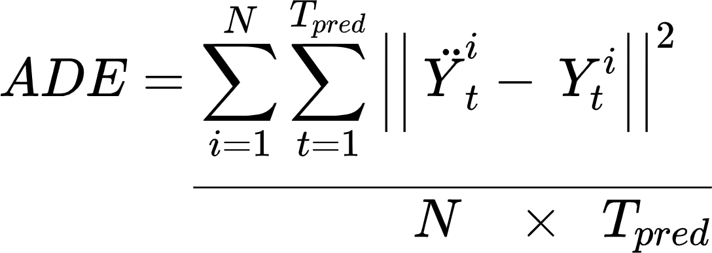
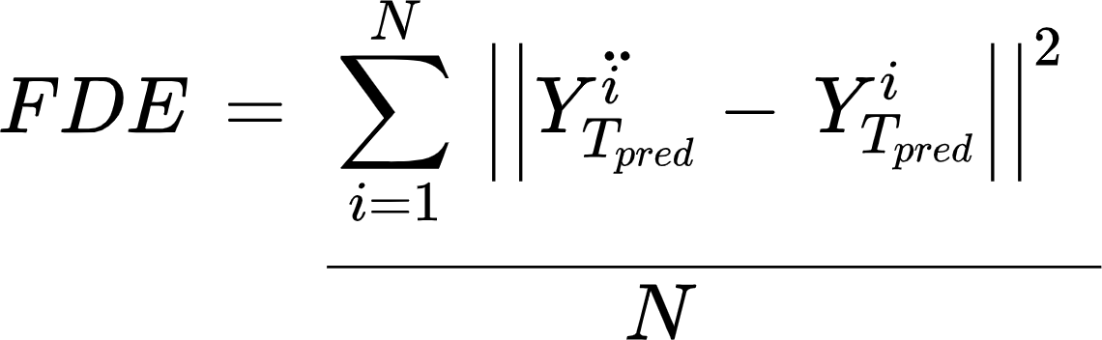
PERFORMANCE METRICS
Average Displacement Error (ADE): The average Euclidean distance between the ground truth coordinates and the prediction coordinates over all time instants.
Final Displacement Error (FDE): The euclidean distance between the predicted points and the ground truth point at the final prediction time instant T_{pred}

Slide 15
REFERENCES
[1] Jinzhuo Wang , Wenmin Wang , Member, IEEE, and Wen Gao, Fellow, IEEE “Predicting Diverse Future Frames With Local Transformation-Guided Masking” IEEE Transactions On Circuits And Systems For Video Technology, Vol. 29, No. 12, December 2019
[2] Z. Li, W. Wang, N. Li, and J. Wang, “Tube convnets: Better exploiting motion for action recognition,” in Proc. ICIP, Sep. 2016, pp. 3056–3060.
[3] P. V. K. Borges, N. Conci, and A. Cavallaro, “Video-based human behavior understanding: A survey,” IEEE Trans. Emerg. Sel. Topics Circuits Syst., vol. 23, no. 11, pp. 1993–2008, Nov. 2013
[4] A. Alahi, K. Goel, V. Ramanathan, A. Robicquet, L. Fei-Fei, and S. Savarese. Social lstm: Human trajectory prediction in crowded spaces. In CVPR, 2016.

Slide 16
REFERENCES
[5] J. Wang, W. Wang, X. Chen, R. Wang, and W. Gao, “Deep alternative neural network: Exploring contexts as early as possible for action recognition,” in Proc. NIPS, 2016, pp. 811–819.
[6] G. Awad, A. Butt, K. Curtis, J. Fiscus, A. Godil, A. F. Smeaton, Y. Graham, W. Kraaij, G. Qunot, J. Magalhaes, D. Semedo, and S. Blasi. Trecvid 2018: Benchmarking video activity detection, video captioning and matching, video storytelling linking and video search. In TRECVID, 2018.
[7] W. Lotter, G. Kreiman, and D. Cox. (May 2016). “Deep predictive coding networks for video prediction and unsupervised learning.” [Online].
[8] W. Choi and S. Savarese. Understanding collective activities of people from videos. IEEE transactions on pattern analysis and machine intelligence, 36(6):1242–1257, 2014.

